Slide 1
Modeling Blue Nile Diamond Price
By Arti Patel, Mariah Hurt, Elizabeth Driskill, & Sudeepti Surapaneni

Slide 2
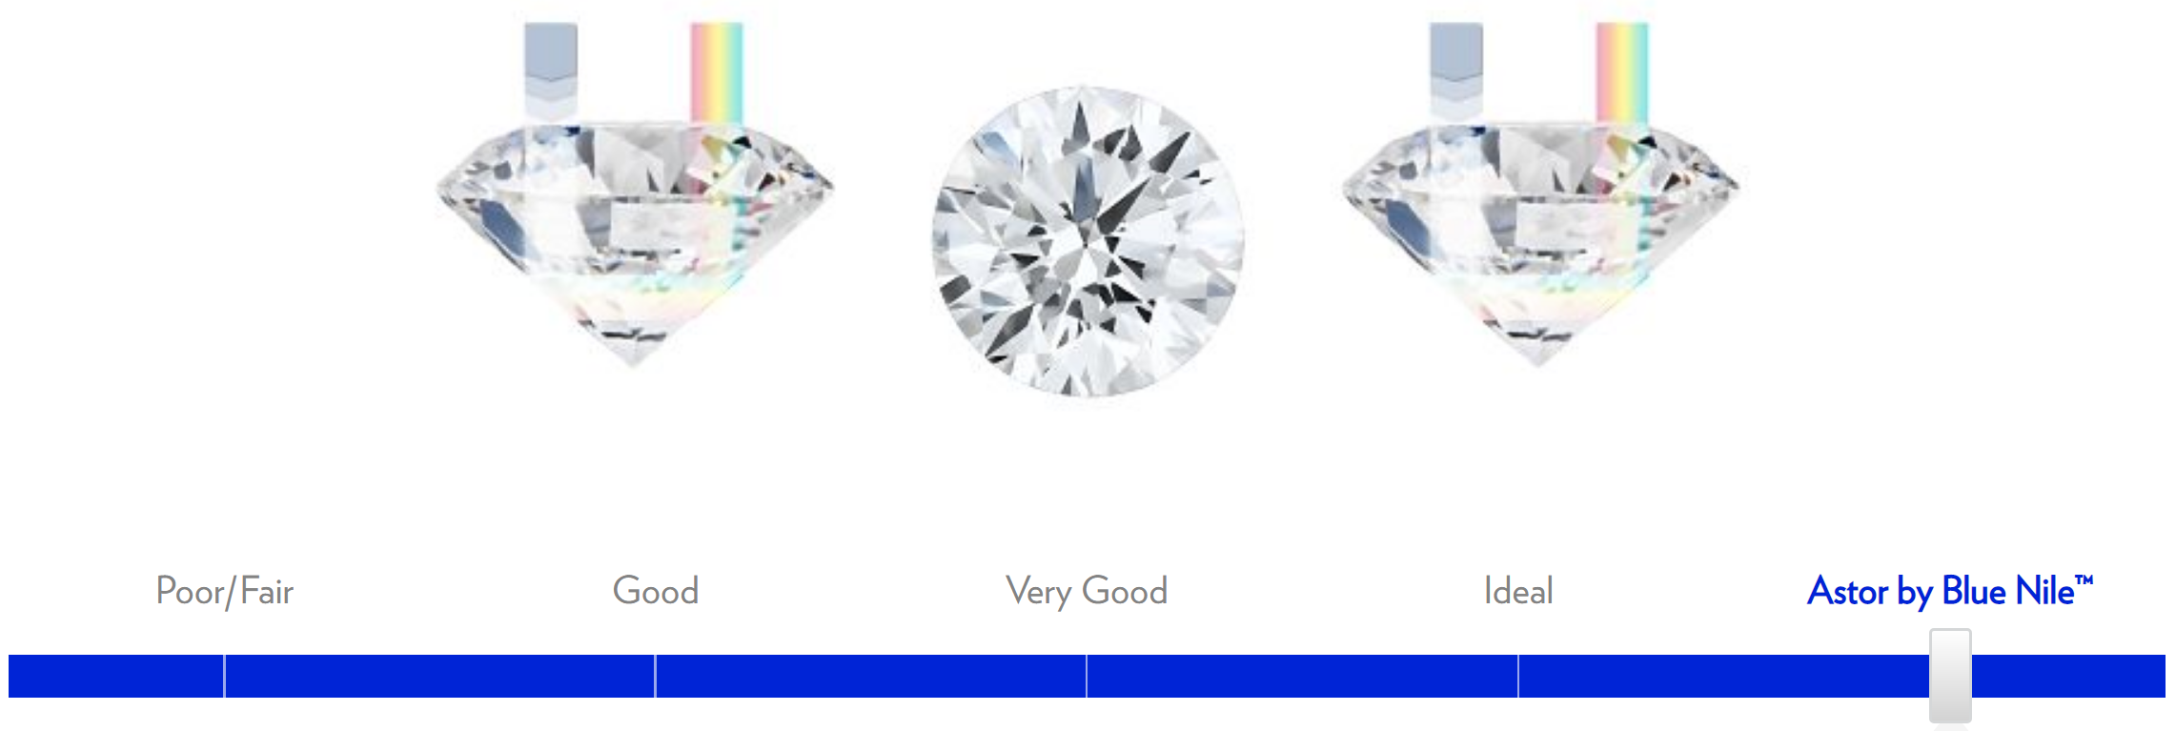
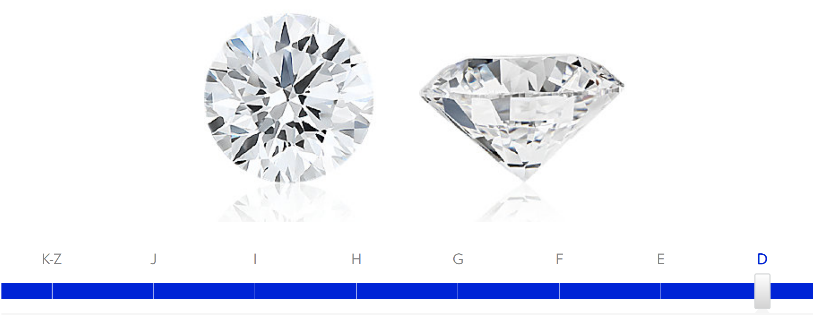
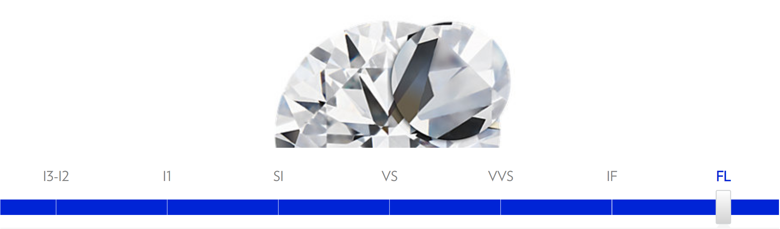
Introduction
Blue Nile website
4 C’s: Carat, Cut, Color, Clarity
2 quantitative variables
Price
Carat
3 categorical variables
Cut
Color
Clarity
Notes:
Mariah
-Our high level goal was to predict price
-comes from blue nile
-the four c’s are used for assessing quality

Slide 3
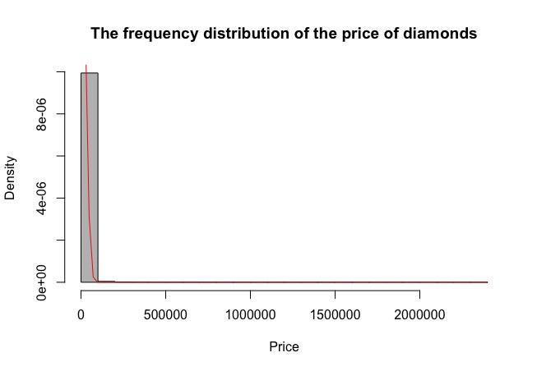
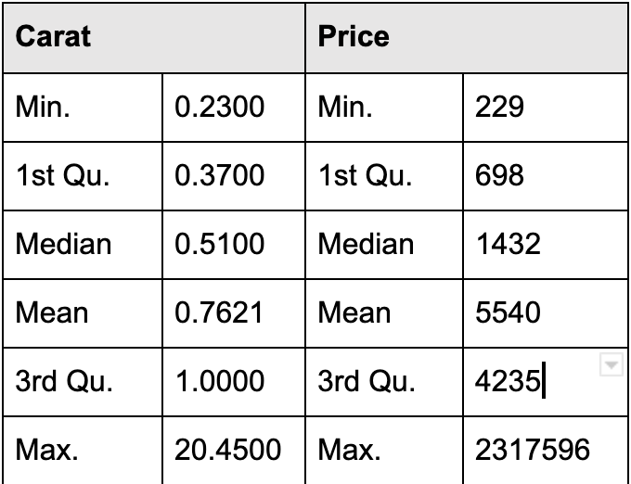
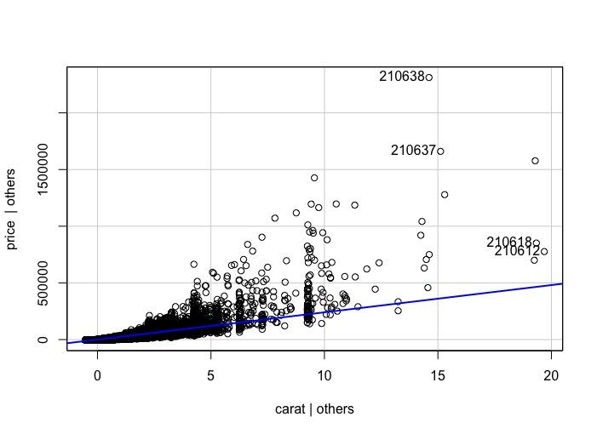
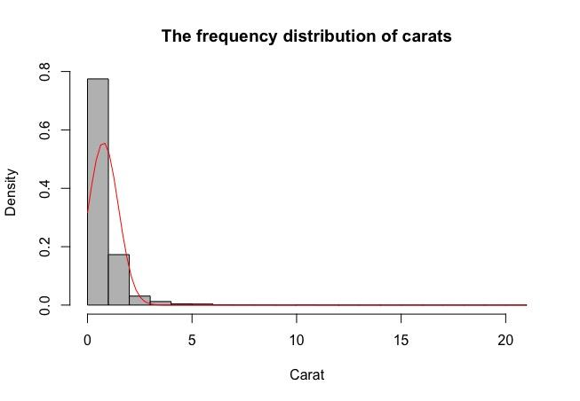
Initial Variable Exploration
Summary statistics for price and carat
AV plot for price and carat
Histograms
Non-normal distribution
Notes:
Sudeepti
-We Used the R function unique to explore what all the unique values of the variable were
-¾ variables were categorical so we started doing initial variable exploration on price and carat
-the av plot is to assess the importance of carat as a predictor and the non-zero slope indicates that it is an important predictor
-histograms showed a non-normal distribution for both price and carat
In order to assess the data and understand each of the four c’s in context, we used the unique() function in R to explore all the unique values of the variables
For the categorical variables, we created dummy variables to represent indicators for each unique value of cut, color, and clarity.
Since the three of the four independent variables were categorical variables we started initial variable exploration on price and carat
We used the av plot to assess the importance of carat as a predictor
the non-zero slope of the av plot also indicates that carat is an important predictor
additionally, the histograms that we have here show a non-normal distribution for both price and carat

Slide 4
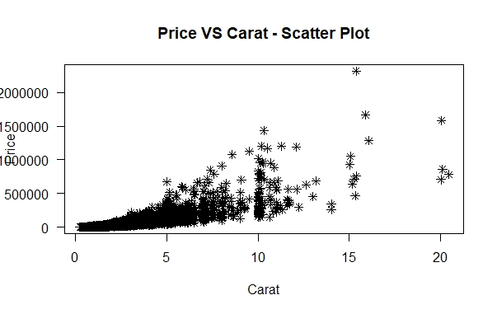
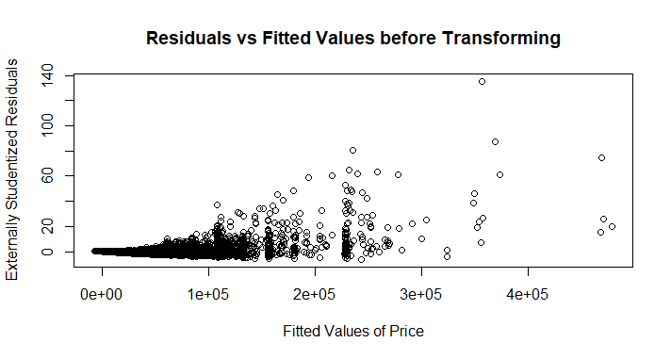
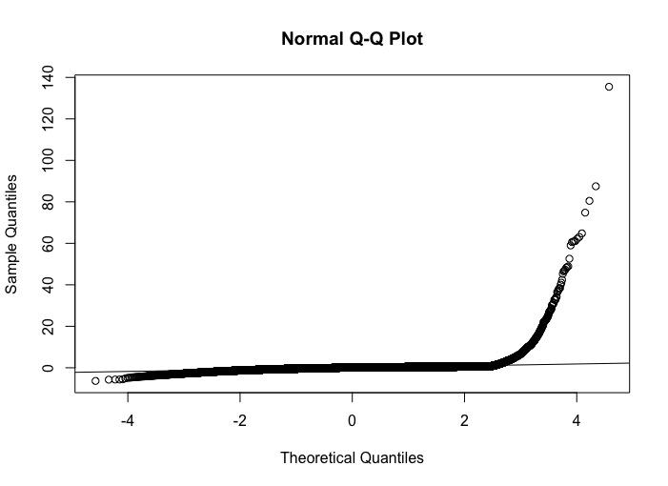
Model Fitting (pre-Transformation)
price ~ carat + cut + color + clarity
Residuals show non-constant variance
Significant deviations from straight line in QQ plot
Price and carat are not linearly related
Data needs to be transformed
Notes:
Elizabeth
Our initial model did not include any transformations. We included all four variables, carat, cut, color, and clarity, as predictors for price.
As you can see in the plot of externally studentized residuals vs. fitted values of price, there is a significant fanning out pattern. This violates the assumption of constant variance.
Additionally, the QQ plot shows significant deviations from the straight line, so we could not assume normality.
Finally, in the scatter plot of price vs. carat, you can see that the data does not follow a linear pattern.
Given all of this information, we decided that the data would need to be transformed in order to produce a better model.

Slide 5
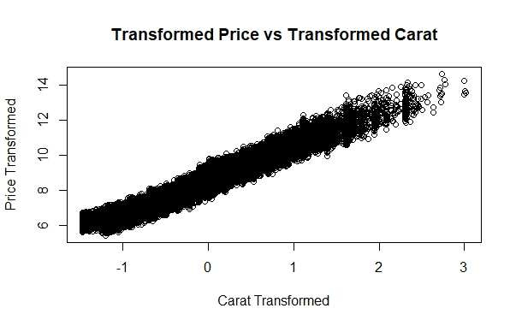
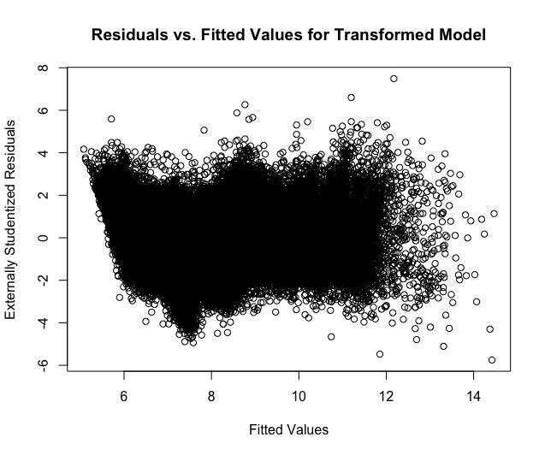
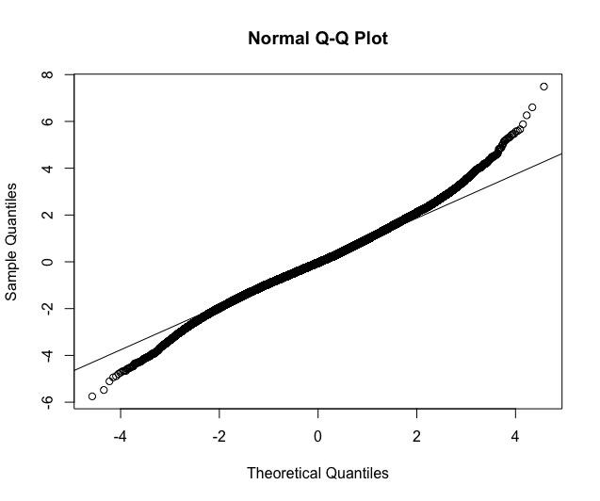
Model Fitting (post Transformation)
ln(price) ~ ln(carat) + cut + color + clarity
Residuals show constant variance
No significant deviations from straight line in QQ plot
Transformed price and carat are now linearly related
Notes:
Arti
We thought fan shaped pattern resembled expectation y^2, so we tried delta method and used log(price).
Since price and carat had similarly skewed distributions, we thought of applying same transformation to carat.
We confirmed the transformation by checking lambda in the box cox procedure, lambda -0.02 verified our log transformation.

Slide 6
Multicollinearity (VIF test)
Variance inflation factors
Correlation matrix
No evidence of multicollinearity
Include every regressor in the model
Carat_t | Cut | Color | Clarity
1.059753 | 1.057626 | 1.037056 | 1.041533
Notes:
Sudeepti
To evaluate our data for signs of multicollinearity, we solved for the variance inflation factors which quantify the severity of multicollinearity
we calculated the VIFs in R and we received the following output
and Since all the values were relatively small or less than 5 (< 5), we concluded that the data did not exhibit significant multicollinearity.
We also produced the correlation matrix in R, and this further confirmed our conclusion that the data did not show multicollinearity because none of the correlation coefficients between variables were significant.
Given all these results and factors, we therefore decided to include every regressor in our model

Slide 7
Interaction Effects
We tested significance of interaction effects of carat with every other variable
The incentive to add interaction variables was more reasoning based - people in the market for carat heavy diamonds may be also looking for ideal cut, clear color or flawless clarity, which would drive up price for diamonds that satisfy those thresholds.
Carat x every other regressor was statistically significant - all terms passed the partial F test
ln(price) ~ ln(carat) + cut + color + clarity + ln(carat):cut + ln(carat):color + ln(carat):clarity
Notes:
Arti

Slide 8
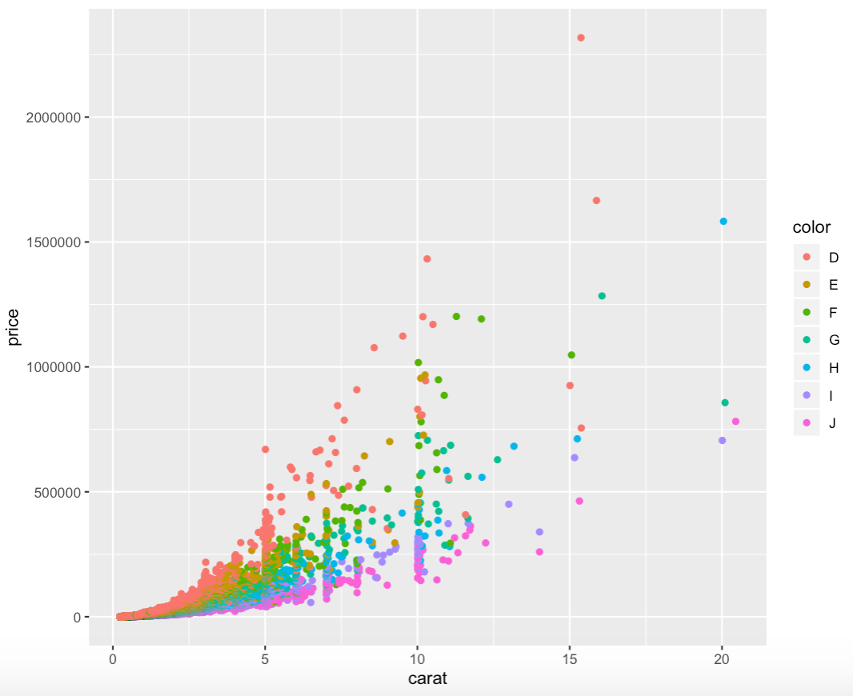
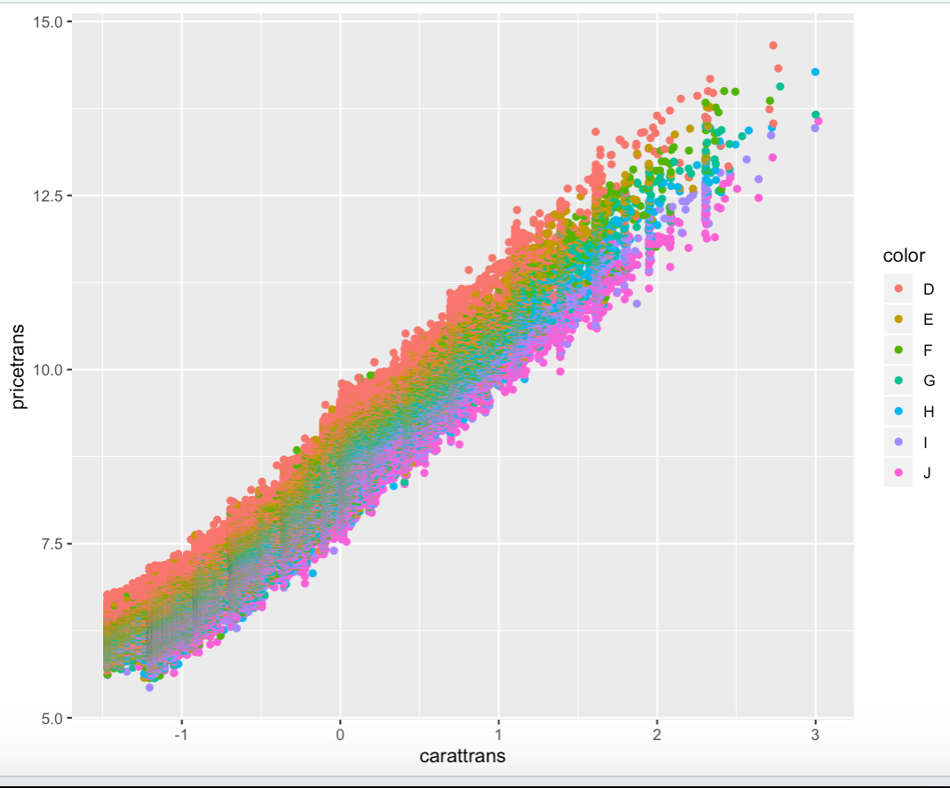
Final Model
ln(price) ~ ln(carat) + cut + color + clarity + ln(carat):cut + ln(carat):color + ln(carat):clarity
Prediction intervals for price
Exponentiate interval outputs due to log transformation
Pre-Transformation
Post-Transformation
Notes:
Mariah

Slide 9
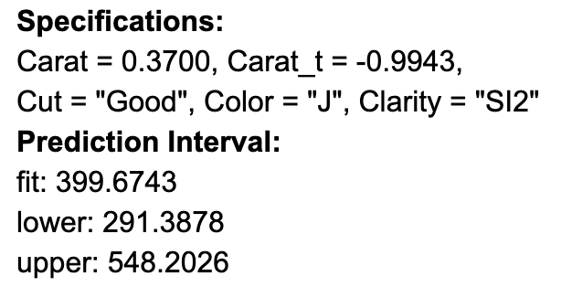
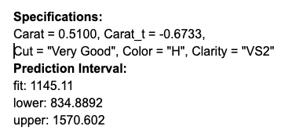
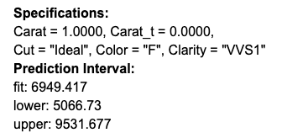
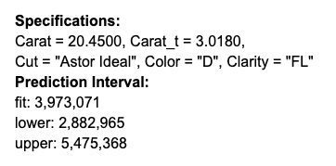
Application
What price can you expect for a diamond with particular parameters?
What price point should I sell my diamond at if I want to sell?
Is the diamond that I am considering buying a “good deal” or a “bad deal”?
This model could be used in a diamond price prediction application
Notes:
Elizabeth
The main goal of our model was to be able to predict the price range of a diamond given specifications about the carat, cut, color, and clarity.
Four example prediction intervals for the price can be seen here, all with different specifications.
This model could be useful to a potential buyer to determine whether or not they are paying a fair price for a particular diamond.
It may also be helpful to sellers to decide their price point for a given diamond.
Overall, we were able to conclude that our model did fulfill our goal of being able to predict diamond price.

Slide 10
Thank You

